Slide 1
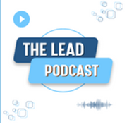
A Discussion of Pulsed Field Ablation for the Treatment of Atrial Fibrillation: PULSED AF Pivotal Trial
Hosted by William H. Sauer, MD, FHRS, CCDS

Slide 2
Article Information:
Article for Discussion: Pulsed Field Ablation for the Treatment of Atrial Fibrillation: PULSED AF Pivotal Trial
Authors: Atul Verma, David E. Haines, Lucas V. Boersma, Nitesh Sood, Andrea Natale, Francis E. Marchlinski, Hugh Calkins, Prashanthan Sanders, Douglas L. Packer, Karl-Heinz Kuck, Gerhard Hindricks, Birce Onal, Jeffrey Cerkvenik, Hiroshi Tada, David B. DeLurgio on behalf of the PULSED AF Investigators

Slide 3
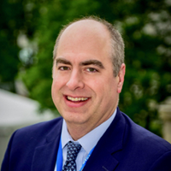
Today’s Host
William H. Sauer, MD, FHRS, CCDS
Brigham and Women's Hospital

Slide 4
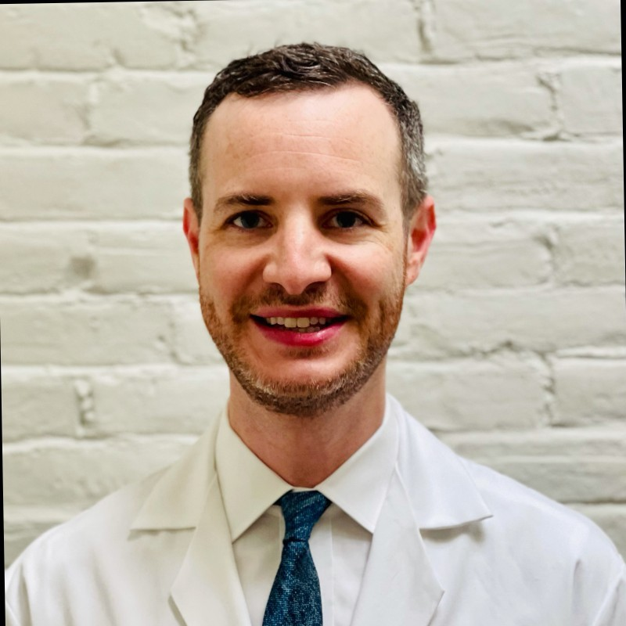
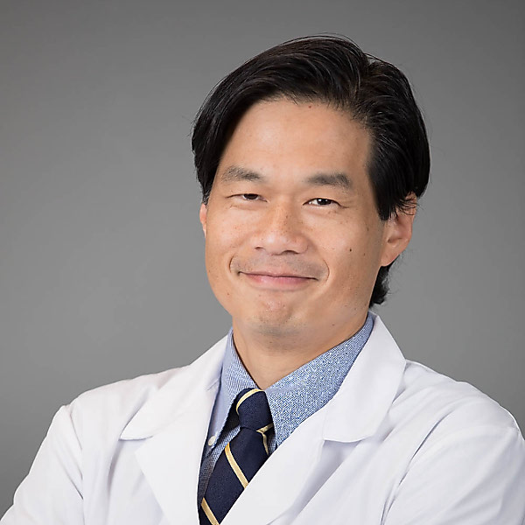
Today’s Contributors:
Nathaniel Steiger, MD
Brigham and Women's Hospital
Paul C. Zei, MD, PhD, FHRS
Brigham and Women's Hospital

Slide 5
Disclosures:
William H. Sauer, MD, FHRS, CCDS
Honoraria/Speaking/Consulting: Biotronik, Biosense Webster, Inc., Abbott, Boston Scientific
Research: Medtronic
Nathaniel Steiger, MD
Nothing to disclose.
Paul C Zei, MD, PhD, FHRS
Honoraria/Speaking/Consulting: Varian Medical Systems, Biosense Webster, Inc., Abbott
Research: Biosense Webster, Inc.
Stocks, Publicly Traded: Affera, Inc.

Slide 6
Thank you!

